Slide 1

Boston City Power Consumption
Group 4
Ananya Chakravarty
Rohit Nigam
Rohit Nikam

Slide 2

Dataset
Given dataset included multiple csv files containing power consumption data belonging to 10 different departments in the city of Boston, MA.
The dataset had the following attributes – Time, Day, Month, Year, kWh, kVARh and Power Factor.
Each department had multiple accounts and channels. kWh gives the power consumption through each of the channel per account and department.
kWh is calculated by multiplying kVARh with PowerFactor.

Slide 3

Approach
A dashboard to enable easy online access and visualization of energy data for different departments in Boston.
User can see the predicted power consumption value in kWh by selecting the time, day and month.
User can choose between multiple departments, timeframe and unit to visualize the prediction data.

Slide 4

Tools Involved :
R
Microsoft Azure
Tableau
Visual Studio
JSON
Bootstrap
HTML/CSS
Javascript

Slide 5

Dataset Pre-processing in R
The dataset had incorrect values (outliers), missing and null values. Some of the data belonging to different channels were duplicates and some were inappropriate.
We cleaned the dataset by doing the following in R:
Split date to get daily and monthly predictions
Transpose Time to get it as one of the attribute
Transpose Unit and Value to get kWh, kVARh and PowerFactor.
Convert the format of date(string) as a date time for visualization
One file per department

Slide 6
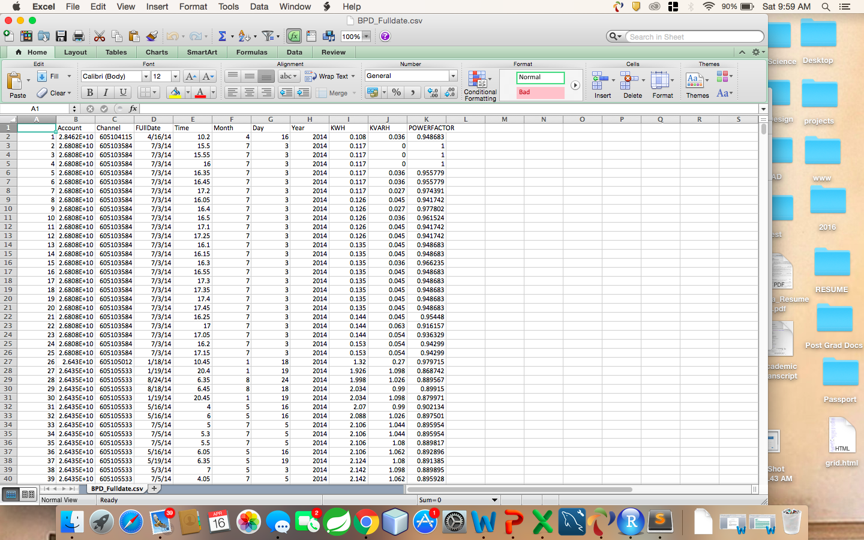
Dataset

Slide 7
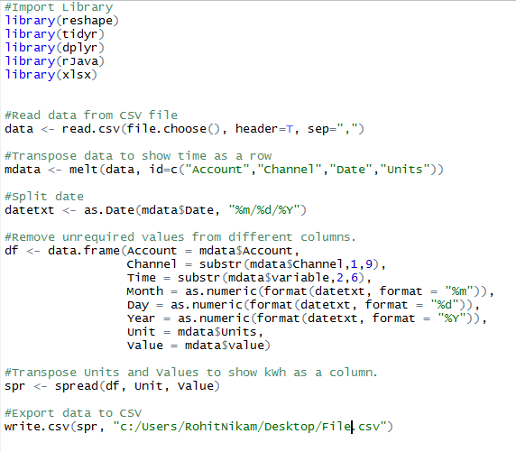

Dataset Pre-processing in R

Slide 8

Azure Model
Used Projected Column to filter out the columns which did not contribute to our prediction.
Split the data as Train and Score (70% traning)
Used Boosted Decision Tree Regression to predict kWh values. This is a supervised learning method to create ensemble of regression trees
We chose kWh as our output/predicted value
We excluded Power factor

Slide 9
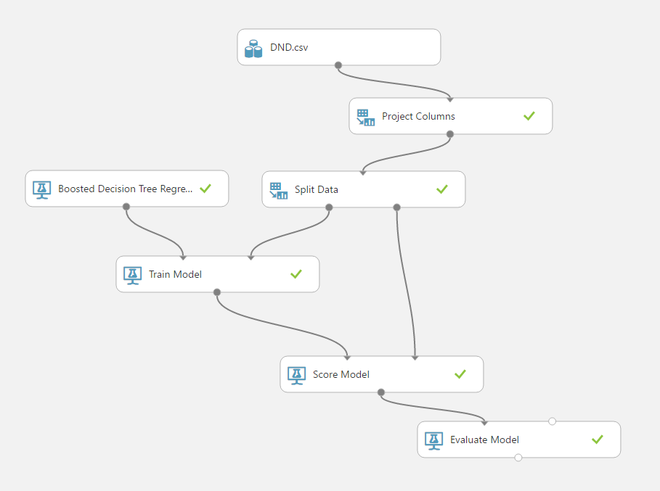
Azure Model

Slide 10
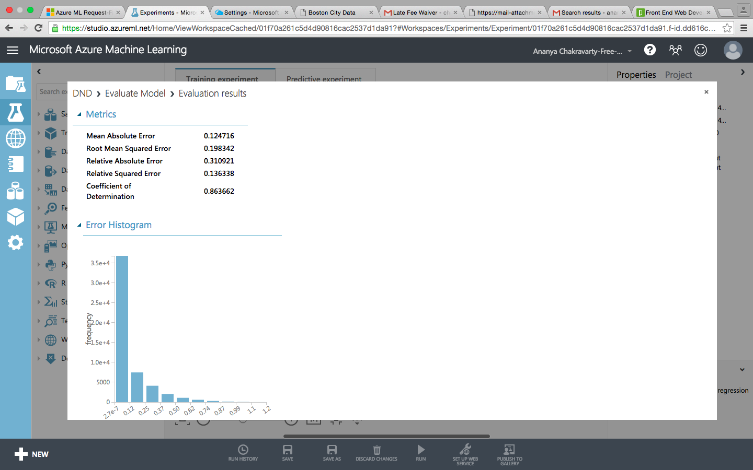
Model Evaluation

Slide 11
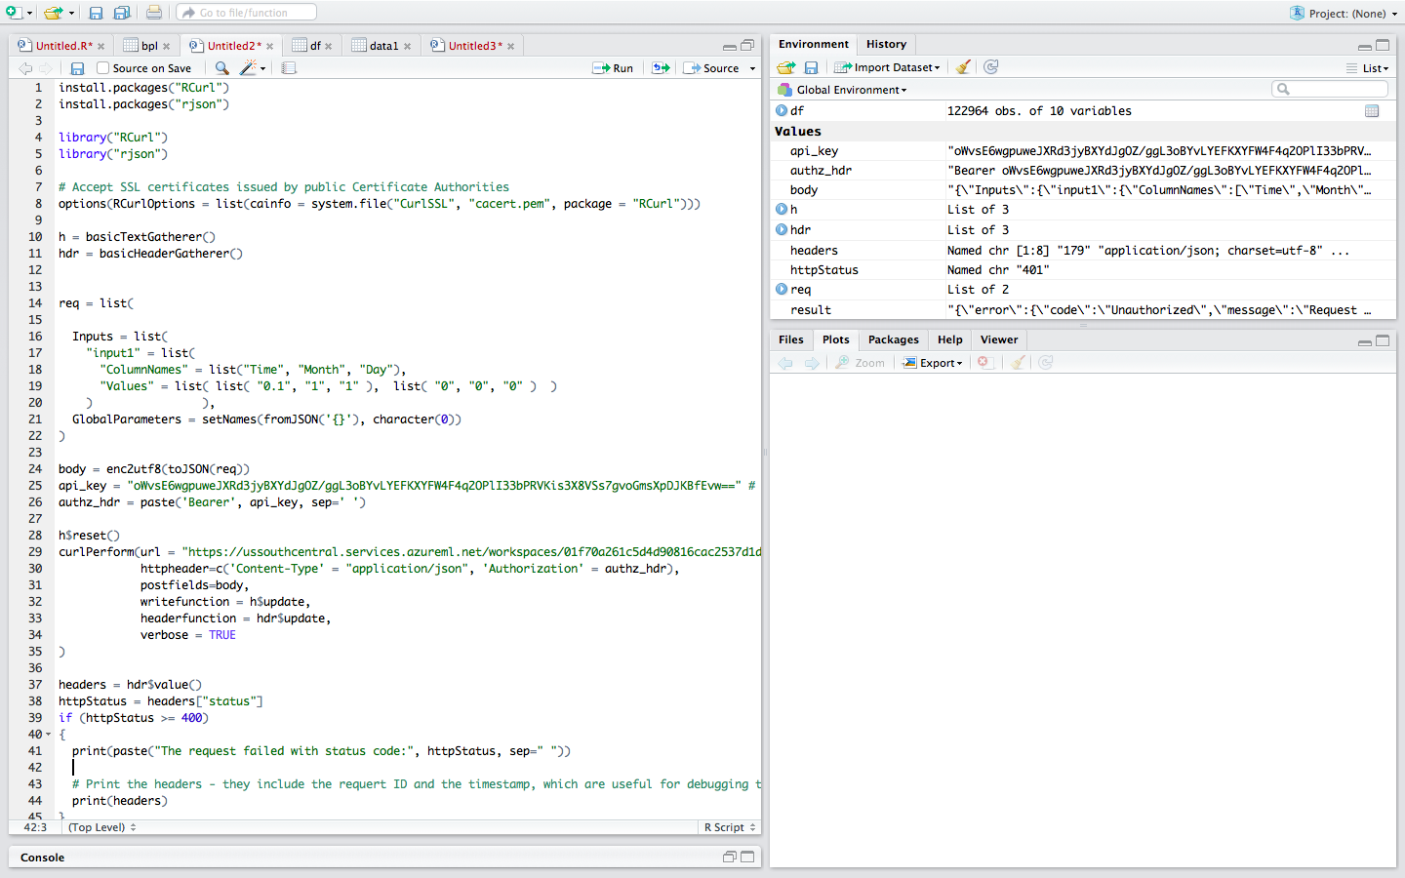
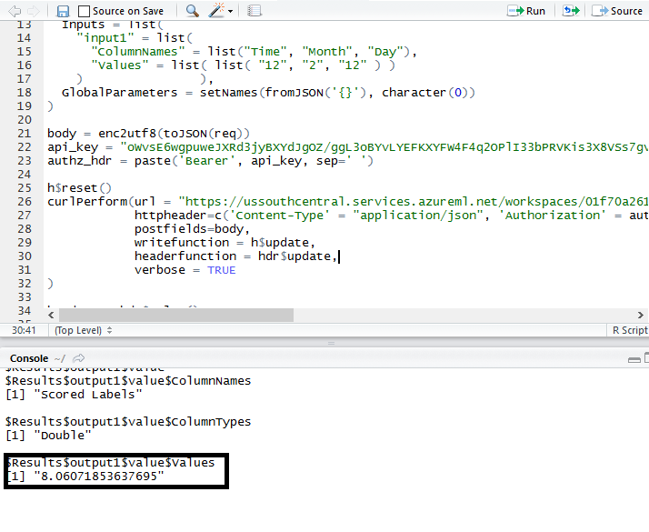
kWh Prediction using R
Predicted KWH:

Slide 12
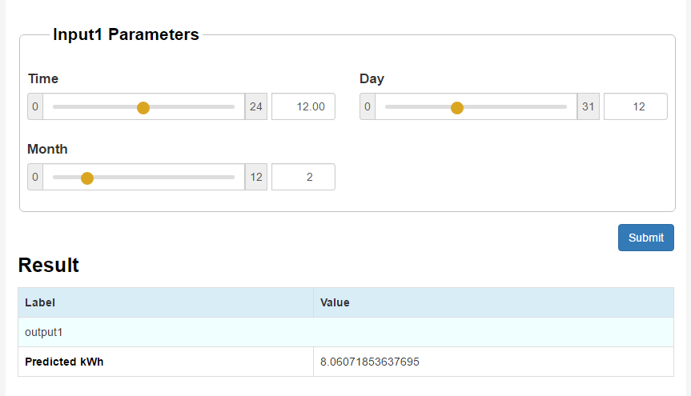
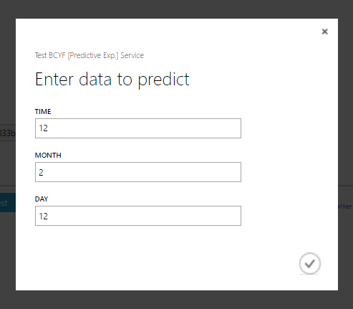

kWh Prediction using WebApp

Slide 13
Web Application Demo

Slide 14
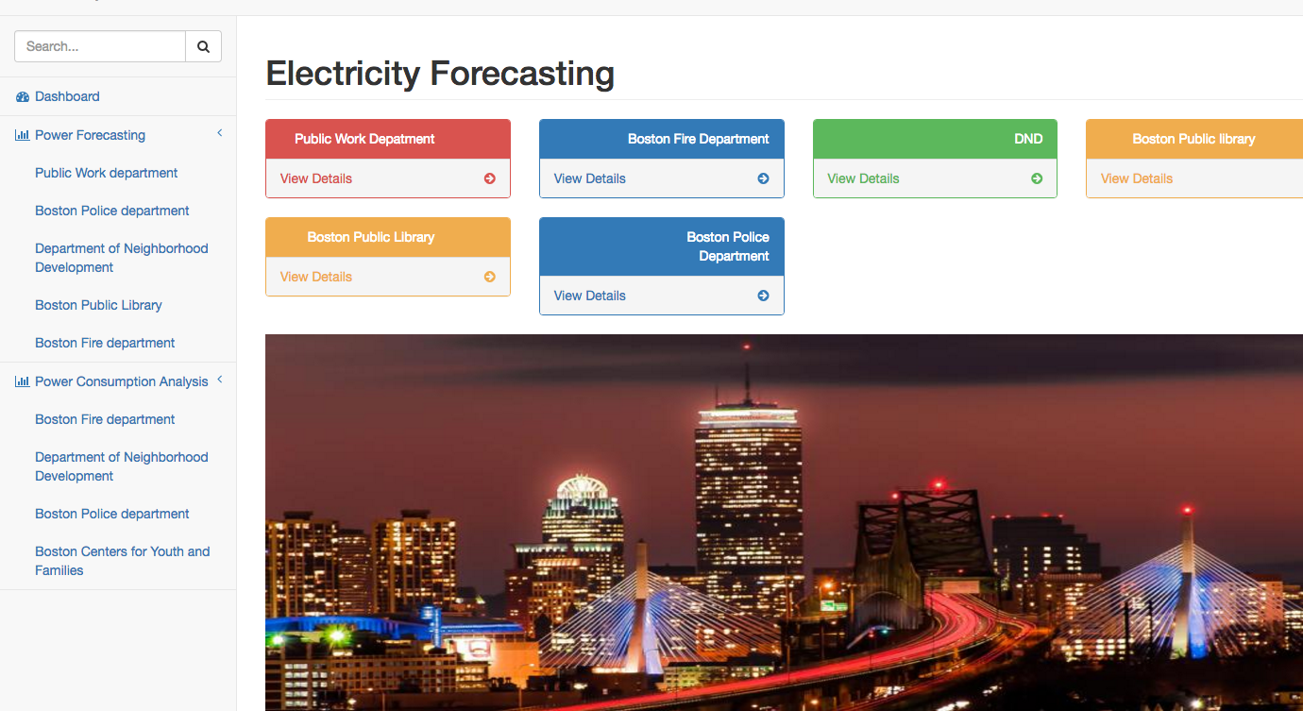
Dashboard

Slide 15
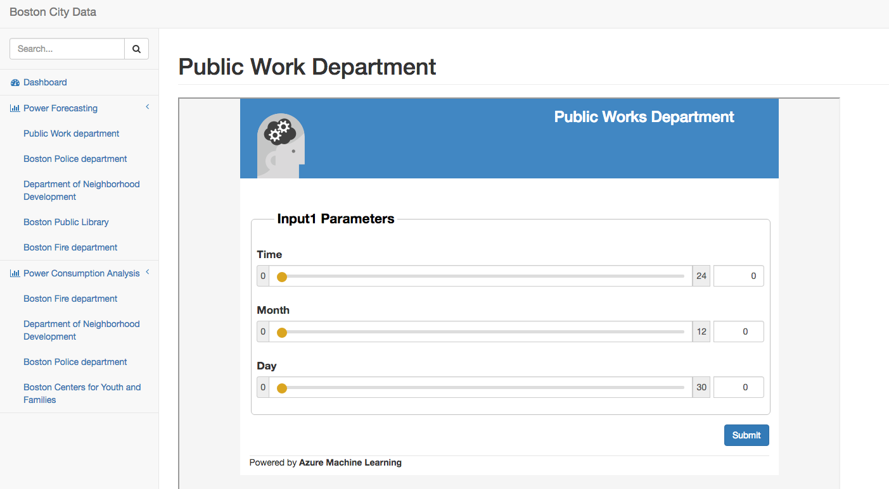
PWD Power Prediction

Slide 16
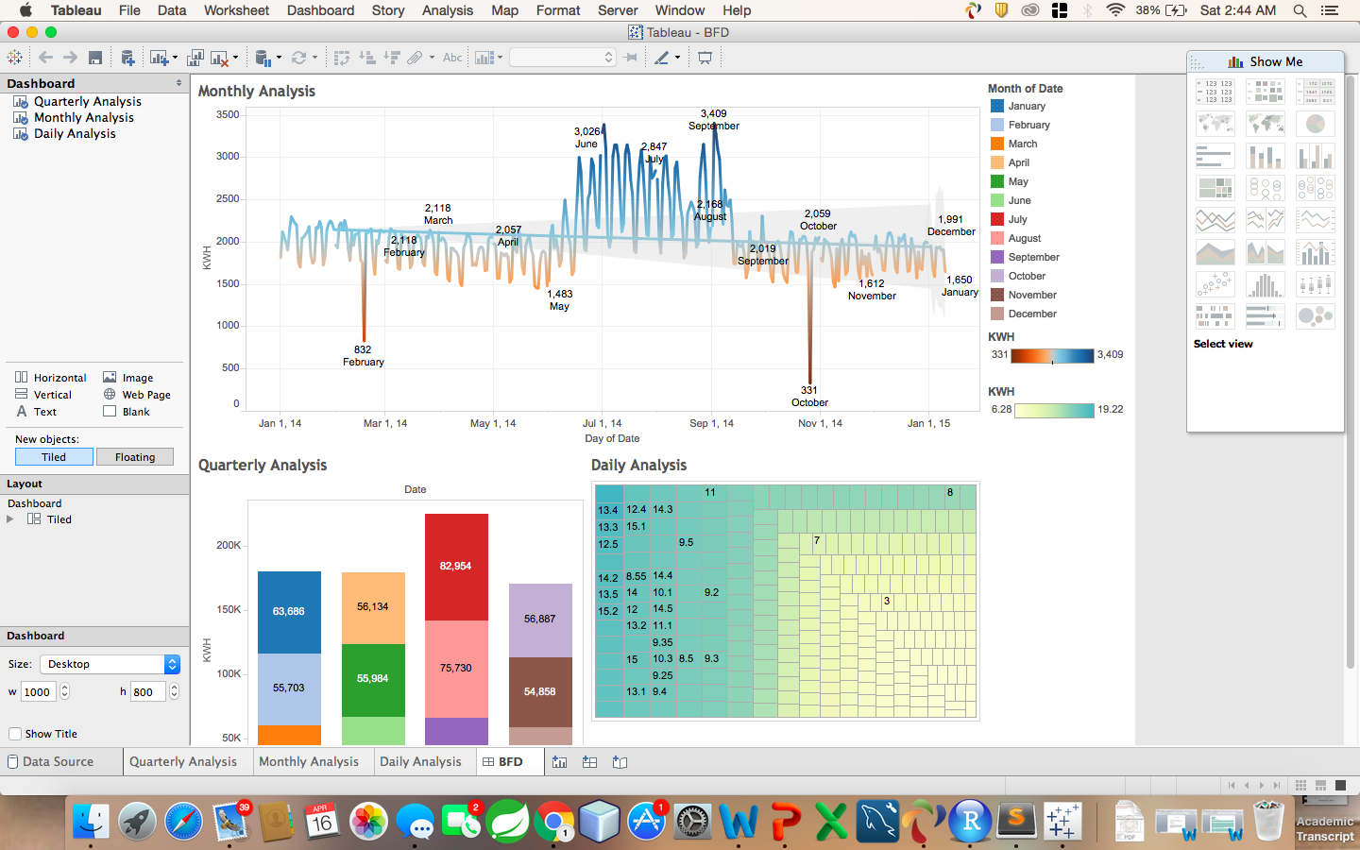
BFD Visualization

Slide 17
Thank You

